Slide 1
What is Windows Presentation Foundation?
Paul Stovell

Slide 2
.NET 1.0
C#
VB.NET
Etc.
ADO.NET
Windows Forms
ASP.NET
Base Class Library
Common Language Runtime

Slide 3
.NET 1.1
C#
VB.NET
Etc.
ADO.NET
Windows Forms
ASP.NET
Base Class Library
Common Language Runtime

Slide 4
.NET 2.0
C#
VB.NET
Etc.
ADO.NET
Windows Forms
ASP.NET
Base Class Library
Common Language Runtime

Slide 5
.NET 2.0
WinFX
C#
VB.NET
Etc.
Windows Presentation Foundation
ADO.NET
Windows Forms
ASP.NET
Windows Workflow Foundation
Base Class Library
Windows Communication Foundation
Common Language Runtime

Slide 6
Enter marketing...

Slide 7
Win FX
.NET 2.0
Windows Presentation Foundation
C#
VB.NET
Etc.
Windows Workflow Foundation
ADO.NET
Windows Forms
ASP.NET
Windows Communication Foundation
Base Class Library
Common Language Runtime

Slide 8
.NET 3.0
.NET 2.0
Windows Presentation Foundation
C#
VB.NET
Etc.
Windows Workflow Foundation
ADO.NET
Windows Forms
ASP.NET
Windows Communication Foundation
Base Class Library
Common Language Runtime

Slide 9
Yeah, that’s what I thought too...

Slide 10
.NET 3.5
C#
VB.NET
Etc.
Windows Presentation Foundation
ADO.NET
Windows Forms
ASP.NET
Windows Workflow Foundation
Windows Communication Foundation
Base Class Library
Common Language Runtime

Slide 11
WPF – Windows or Web?

Slide 12
Tools Visual Studio Expression Blend Expression Design

Slide 14
Top 10
Things to Know
About WPF

Slide 15
DirectX
Number 1
How do you tell an extrovert programmer from an introvert? An extrovert programmer will look at your shoes when he talks to you.

Slide 16
XAML
Number 10
How do you keep a programmer in the shower all day? Give him a bottle of shampoo which says "lather, rinse, repeat."

Slide 17
Layout
Number 11
There are three kinds of lies: Lies, damned lies, and benchmarks.

Slide 18
Content Model
Number 100
How many testers does it take to change a light bulb? We just noticed the room was dark; we don't actually fix the problem.

Slide 19
Styles and Templates
Number 101
The first half of a project takes 90% of the time.
The second half of the project takes the other 90%.

Slide 20
Resources
Number 110
Q: How many Microsoft engineers does it take to change a light bulb? A: None. Bill Gates will just redefine Darkness(TM) as the new industry standard.

Slide 21
Binding
Number 111
1. Two antennas met on a roof, fell in love and got married. The ceremony wasn't much, but the reception was excellent.

Slide 22
Animation
Number 1000
What do you call a fish with no eyes? A fsh.

Slide 23
Dependency Properties
Number 1001
Deja Moo: The feeling that you've heard this bull before.

Slide 24
Interop
Number 1002
Two fish swim into a concrete wall. The one turns to the other and says "Dam!".

Slide 25
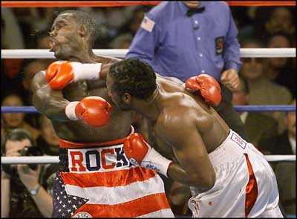
Q and A

Slide 26
fin

